Slide 1
Course 10 – Testing, Validation and Verification
Inginerie Software Anul universitar 2022 - 2023

Slide 2
Agenda
Verification and Validation
Organizing for Software Testing
Test strategy (exemplified on Web Apps)
Project Requirements

Slide 3
What is the difference?
Verification – ensures that software correctly implements a specific function: „Are we building the product right?”
Validation – ensures that the software is traceable to customer requirements: „Are we building the right product?”
Testing – A set of implemented measures that ensure the verification and/or validation of the requirements.

Slide 4
Verification and Validation
Technical reviews
Installation testing
Verification and Validation
Performance monitoring
Acceptance testing
Documentation review
Usability testing
Database review

Slide 5
Software Testing
Software Testing is a set of activities planned in advanced, conducted systematically which can uncover and prevent issues of the system-under-test (SUT)
Creating software can be viewed as a building activity (implementing something you think will stand);
While testing software can be viewed as a destructive activity (trying to prove that it doesn’t stand)
Building Software
Testing Software
Psychologically challenging to be both the builder and the tester

Slide 6
Organizing for Software Testing
Developer responsibility to create the requested artefact, and to create tests that prove that it fulfills the requirement.
Creating Unit tests
Creating Integration tests
Creating Validation tests
Defining an ITG – independent testing group
Ideally you have such a group inside the software engineering team.
Often, you can see that the ITG is outsourced from the SE team to the QA team.

Slide 7
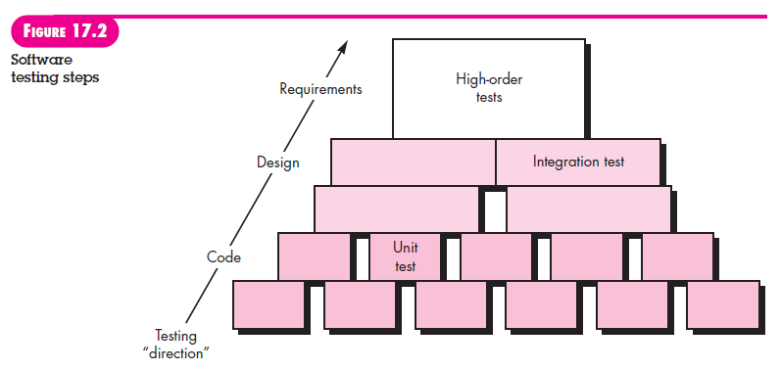
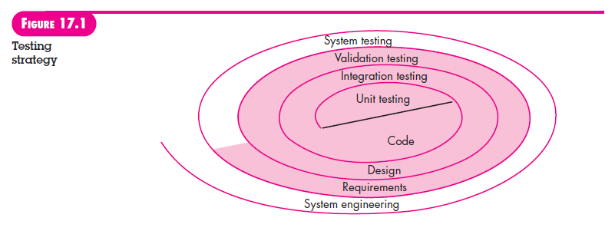
Organizing for Software Testing

Slide 8
Unit testing
Testing the proper flow of data observing the input and output through a single unit of code.
Tests should return error codes or messages
Error handling should:
Be intelligible;
Error noted should correspond to the error encountered;
Have error conditions before error handling;
Error description should point to the location of the error.

Slide 9
Integration testing
If all module works (unit tests are passed), we still need integration testing to check issues in the interfacing between modules.
All integration tests should be able to specify what interface it handles.
Examples:
API (creating a component with both front-end and back-end components)
Database calls (the interface between DB and BE)
Global resources (modules that use the same global variables)

Slide 10
Test strategy for Web Apps
1. Content model for the WebApp is reviewed to uncover errors
2. Interface model accommodates all use cases
3. Design model accommodates navigation
4. Each functional component is unit tested
5. WebApp implementation if tested on all specified environmental configurations
6. Security tests are conducted
7. Performance tests
8. Enabled monitoring of end users usage of WebApp.

Slide 11
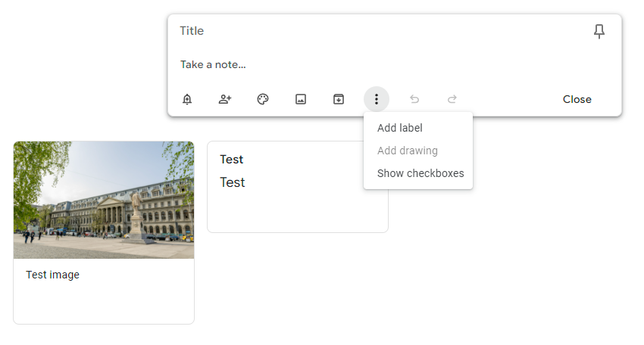
Example on Google Keep
1. Content model
Content: “Notes”
Content types: Text, Images, Files?
Content information: Shared ownership of the note
What happens to labels? Are they shared?

Slide 12
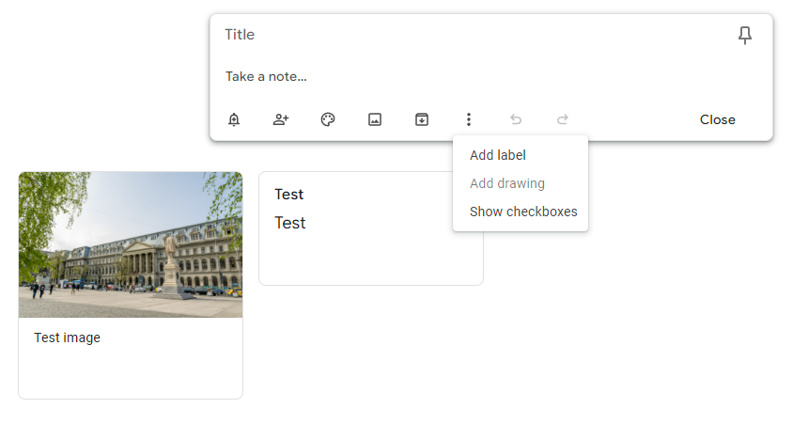
Example on Google Keep
We don’t really know the Use Cases that Keep aimed for, we can just assume they manage to target all of them.
2. Interface model

Slide 13
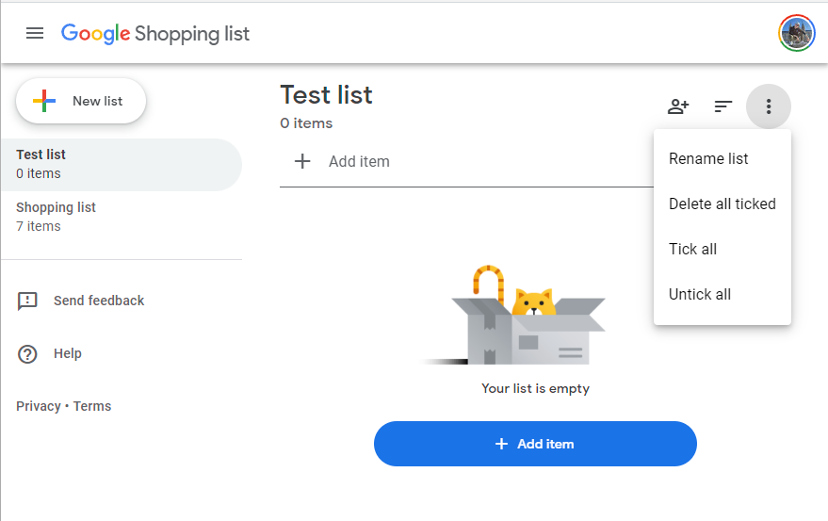
Example on Google Keep
However, they do have a separate application, that could easily be integrated in the first one … Why?
2. Interface model

Slide 14
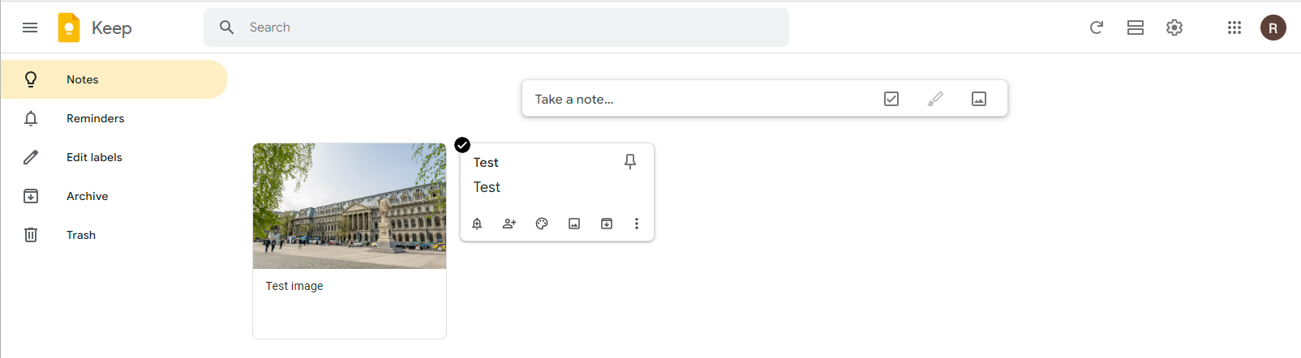
Example on Google Keep
3. Design model
Allows interacting with notes just by focusing, not just after selecting.
Per note options are hidden until focus.

Slide 15
Example on Google Keep
4. Unit tests (no image here)
Testing that “Take a new note…” can generate a new note.
Testing that images can be added
Testing that PDFs can’t be added
Testing that drawing can be triggered only on touch devices
Testing that the order of the notes is chronological

Slide 16
Example on Google Keep
5. Environmental configurations
Check for responsiveness
Enable drawing on touch devices.
Going offline behaviour
For example Google Keep doesn’t let you add an image to a new note while offline, but it allows you to add an image to an existing image while offline.

Slide 17
Example on Google Keep
6. Security tests are conducted
OWASP Top 10 is a good starting point
SQL injection is an easy one.

Slide 18
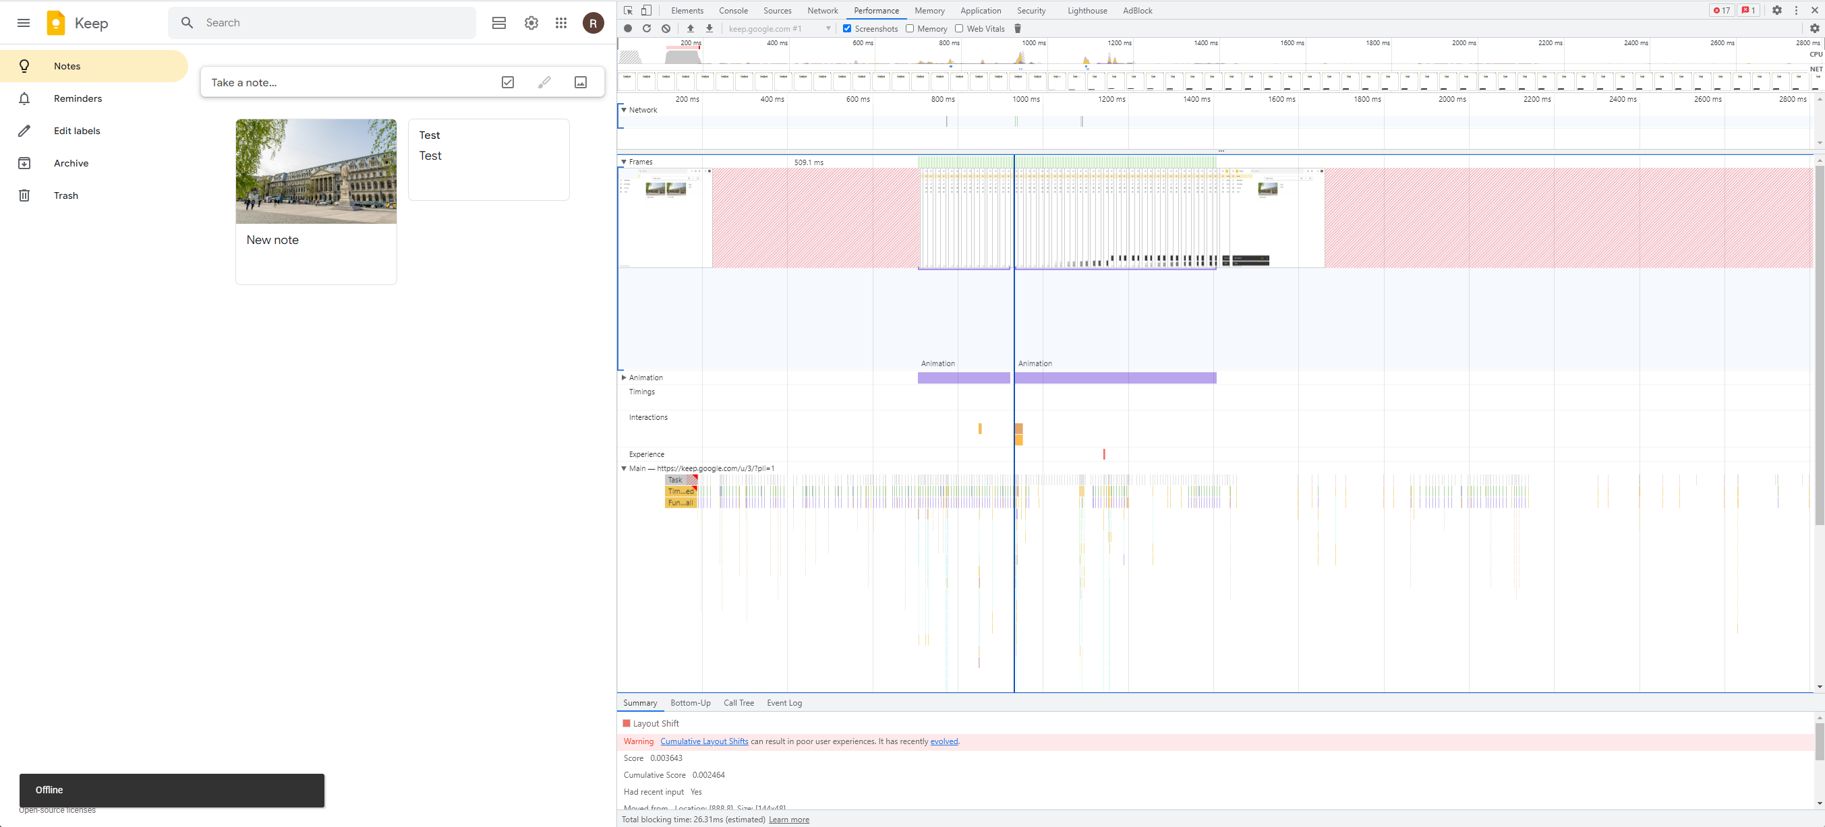
Example on Google Keep
7. Performance test
Use performance metrics to evaluate application
Identify which are the more valuable metrics for your application.
You can combine it with an automated script that aims to be as fast as possible.

Slide 19
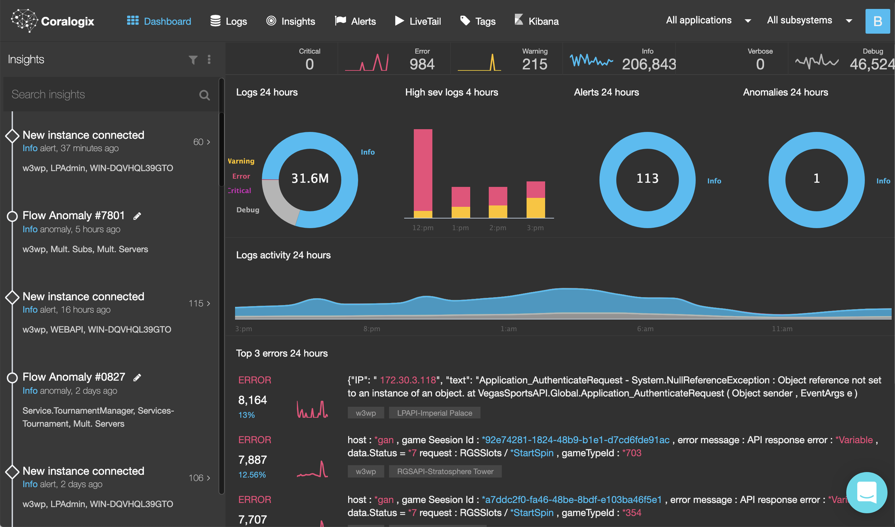
Example on Google Keep
8. Enable monitoring of user activity
Identify what the most valuable information about the application usage
Volume of data throughput
Number of requests
Speed of response
Create actionable information from collected data
Use a tool that analyzes logs and offers information e.g. Coralogix, GreyLog

Slide 20
Test Strategy Requirements
This is what you will have to do as part of the final deliverable:
Create a QA report (following the test strategy described here, or similar)
Create tests that cover your app (not particularly interested in coverage as a metric)
Trace the non-functional requirements to (unit / integration) tests that validate the requirement
If a test cannot be created justify why.
Trace functional requirements to test scenarios that validate the implementation
Can be automated or a manual test procedure.
Report on the security concerns that you have addressed in your implementation
Report on the environments covered by your application.
Identify at least one relevant metric for you application, that you can measure
e.g. the time needed to complete an operation; how many requests can the app handle (using for example Postman or Jmeter);

Slide 21
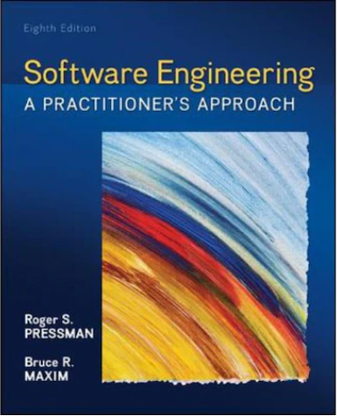
Sources
Based on Pressman, Roger S.; Maxim, Bruce R., Software engineering: a practitioner's approach. Palgrave Macmillan, 8th edition, 2014.
Link to 7th edition

